Slide 1
Decarbonization Pathways, Policies, and Programs in New England
It Takes the Whole Village
September 25, 2020
Framing Policy & Program Design: An Equitable & Just Pathway to Net Zero
Eugenia Gibbons
Boston Director of Climate Policy, Health Care Without Harm

Slide 2


1996
Health Care Without Harm works to transform health care worldwide so that it reduces its environmental footprint, becomes a community anchor for sustainability and becomes a leader in the global movement for environmental health and justice.
36,000
Our reach includes 36,000 hospitals and health centers in 60 countries worldwide.
Notes:
Health Care Without Harm is an international nonprofit organization that works to transform health care so that it reduces its environmental footprint, becomes a community anchor for sustainability and resilience, and a leader in the global movement for environmental health and justice. The organization an international network of 36,000 hospitals in over 60 hospitals including over 1200 hospitals in the United States.
We convene the Health Care Climate Council, which is a leadership body of 19 health systems in 36 states who are committed to climate solutions and protecting public health from the impacts of climate change.

Slide 3
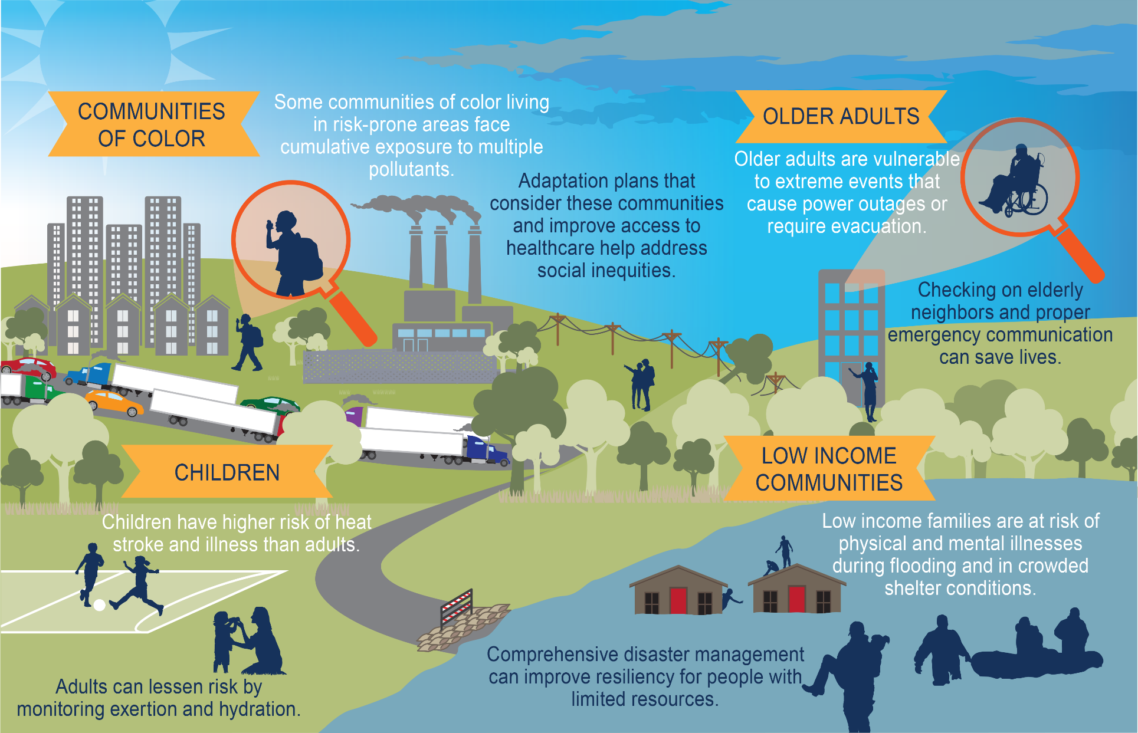
Why hospitals?
". . . Our racial inequality crisis is intertwined with our climate crisis. If we don’t work on both, we will succeed at neither.”
- Ayana Elizabeth Johnson
4th National Climate Assessment. https://nca2018.globalchange.gov/
Notes:
Health care sector accounts for 10% of carbon emissions nationally (hospitals account for about 1/3 of that), 18% of GDP.
In Massachusetts, the sector is the largest employer – half a million people – and one of the largest real estate holders.
The sector not only has a mission to heal and a mandate to do no harm, it also has the ability to transform markets and the economy while doing so.
4th National Climate Assessment.
https://nca2018.globalchange.gov/
USGCRP, 2018: Impacts, Risks, and Adaptation in the United States: Fourth National Climate Assessment, Volume II [Reidmiller, D.R., C.W. Avery, D.R. Easterling, K.E. Kunkel, K.L.M. Lewis, T.K. Maycock, and B.C. Stewart (eds.)]. U.S. Global Change Research Program, Washington, DC, USA, 1515 pp. doi: 10.7930/NCA4.2018.
The Global Change Research Act of 1990 mandates that the U.S. Global Change Research Program (USGCRP) deliver a report to Congress and the President no less than every four years that “1) integrates, evaluates, and interprets the findings of the Program…; 2) analyzes the effects of global change on the natural environment, agriculture, energy production and use, land and water resources, transportation, human health and welfare, human social systems, and biological diversity; and 3) analyzes current trends in global change, both human-induced and natural, and projects major trends for the subsequent 25 to 100 years.”¹

Slide 4

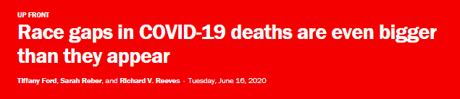
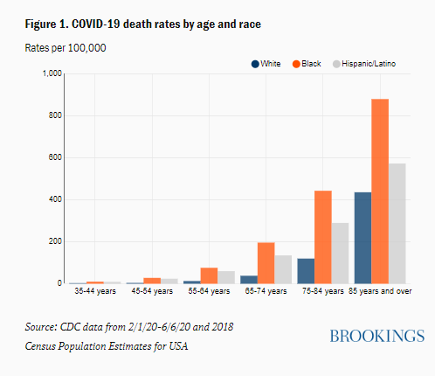

Children in Franklin Square, Baltimore play in a temporary splash park
Ian Morton for NPR

Slide 5
Framing Policy & Program Design:
An Equitable & Just Pathway to Net Zero
Notes:
I have been asked to discuss how we frame policy and program design so that climate plans and policies reflect the desire to achieve equitable transformation.

Slide 6
GWSA IAC Climate Justice Working Group
Equity must be a factor in evaluating the GWSA policy, the Roadmap to 2050, and the 2030 CECP.
GOAL: To make sure that Massachusetts is on target for achieving the 2030 and 2050 greenhouse gas emission reductions while ensuring targeted benefits to environmental justice populations and other historically marginalized communities.
  -- CJWG Recommendations for 80 x 50 Study Scenario Planning (Feb.24, 2020)
Climate justice will only be achieved if EEA enacts policies that bring about concrete improvements in the health and lives of communities in the Commonwealth that continue to be disproportionately impacted by pollution and experience the worst impacts of climate change and COVID-19.
  -- CJWG Preliminary Recommendations to Improve the Master Policy List to Address Climate Justice (Aug. 7, 2020)
Notes:
Some ways to implement these goals are to: invest in democratically controlled structures, put communities of color and low-income communities at the front of the line, assign more weight to policy scenarios that benefit environmental justice populations, facilitate people getting better jobs, invest in public institutions, and ensure that low-income resident contribution to policy costs is not a higher percentage of income compared to middle-income resident contributions.

Slide 7
  An Equitable & Just Pathway to Net Zero Emissions
  Goals/Themes from the CJWG Preliminary Recommendations to Improve the Master Policy List to Address Climate Justice (Aug. 7, 2020)
PEOPLE-CENTERED APPROACH TO ACHIEVE NET ZERO | Acknowledge the disparity. Policies must be holistic and be developed and implemented with community participation.
MEET MULTIPLE OBJECTIVES/ACHIEVE COMPLIANCE WITH MULTIPLE POLICIES & LAWS | Cannot be guided by strict GHG emission reductions alone Re: MA 2050 Roadmap and 2030 CECP - EEA has an obligation to concurrently meet multiple obligations: GWSA, GCA, GJA, EO552 on EJ, and EEA EJ Policy
PRIORITIZE & ANCHOR EQUITY & JUSTICE | Fully value co-benefits, including health impacts of action, or, conversely, the costs associated with inaction. Establish metrics, track progress.
Notes:
This is something that I and countless others have put a great deal of thought into over the years.
We find ourselves at a critical juncture in which the convergence of multiple crises (covid and climate) and a cultural reckoning with systemic, structural racism across the country is forcing us to confront inequity and redress longstanding disparity.
Climate justice will only be achieved when polices are enacted that bring about concrete improvements in the health and lives of communities historically and most disproportionately impacted by pollution and most vulnerable to the worst impacts of climate change.
To the extent possible, resource investment and program design should be data driven and targeted to redress long-standing disparity experienced by communities most vulnerable to effects of climate change and most at risk of pollution, displacement, energy burden, etc. (e.g., geotargeting of EE)
Protections against pollution, disproportionate burden, and displacement must be factored into program design and implementation. (E.g., EJ population definition, MCI protections, enhanced incentives, WFD provisions, etc.)
Complementary policies necessary to achieve balance (ex., congestion pricing) - be holistic
Can’t be guided by strict GHG emissions reductions achieved
Value co-benefits and health impacts of action, but also costs associated with inaction

Slide 8
  Summary of CJWG Preliminary Recommendations to Improve IAC Master Policy List
SECTOR | Overall Policy Recommendations IAC Policy Recommendations (Aug. 22, 2019) | Detailed Implementation Recommendations CJWG Preliminary Recommendations to Improve the Master Policy List to Address Climate Justice (Aug. 7, 2020)
BUILDINGS | 4 | 7
ELECTRICITY | 5 | 9
LAND USE & NATURE-BASED SOLUTIONS | 7 | 17
TRANSPORTATION | 4 | 15
Notes:
This is something that I and countless others have put a great deal of thought into over the years.
We find ourselves at a critical juncture in which the convergence of multiple crises (covid and climate) and a cultural reckoning with systemic, structural racism across the country is forcing us to confront inequity and redress longstanding disparity.
Climate justice will only be achieved when polices are enacted that bring about concrete improvements in the health and lives of communities historically and most disproportionately impacted by pollution and most vulnerable to the worst impacts of climate change.
To the extent possible, resource investment and program design should be data driven and targeted to redress long-standing disparity experienced by communities most vulnerable to effects of climate change and most at risk of pollution, displacement, energy burden, etc. (e.g., geotargeting of EE)
Protections against pollution, disproportionate burden, and displacement must be factored into program design and implementation. (E.g., EJ population definition, MCI protections, enhanced incentives, WFD provisions, etc.)
Complementary policies necessary to achieve balance (ex., congestion pricing) - be holistic
Can’t be guided by strict GHG emissions reductions achieved
Value co-benefits and health impacts of action, but also costs associated with inaction

Slide 9
CJWG Preliminary Policy Recommendations (8/7/20): Buildings
Policy #1: Set Mandatory Emissions Reduction Limits on Building Sector Statewide by 2020
 | EE targets for nonparticipants Revise EE guidelines to account for improved air quality, public health, and worker rights. Implement clean heating/cooling in EJ populations.

Slide 10
CJWG Preliminary Recommendations (8/7/20): Buildings
Policy #3: Require expanded, detailed building performance & emissions reporting, benchmarking, improvements
 | Compare building performance by geography & renter status, ensure high performing building in EJ populations Include code enforcement & education

Slide 11
CJWG Preliminary Policy Recommendations (8/7/20): Buildings
Policy #4: Require cross-sectional focus
 | Prioritize analysis of cumulative impacts, while reducing burdens & increasing benefits to EJ populations

Slide 12
Example: Residential Energy Efficiency
“NON-PARTICIPANTS” | Renters Moderate Income Customers People with limited English proficiency
BARRIERS TO PARTICIPATION | Pre-Weatherization issues Upfront Costs Landlord/Tenant Split Incentive
PEOPLE-CENTERED PROGRAM/POLICY SOLUTIONS | Bring community partners/CBOs/trusted voices to the table from the beginning Outreach strategy, program delivery, workforce development Collect & utilize program data to identify areas with low penetration Use state-designated EJ population data to streamline and identify priority communities Set and meet targets for number of non-participants served by specific dates Value ALL the benefits
Notes:
Non-participants are paying more as a proportion of income (energy burden) and thus would benefit the most from money saving energy efficiency.
On serving non participants that state and Pas should be doing this anyway so it’s important that they do so…perhaps some consideration made to tying performance incentive to metric.

Slide 13
Hospitals – Climate, Health, & Equity
Notes:
I have been asked to discuss how we frame policy and program design so that climate plans and policies reflect the desire to achieve equitable transformation.

Slide 14
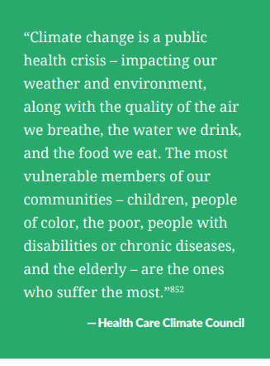
Congressional reports on the need for climate action
Reports highlight health impacts of climate change and the need for climate-smart health care.
  Solving the Climate Crisis: A Congressional Roadmap for Ambitious Climate Action
  House Select Committee on the Climate Crisis
  June 30, 2020
  The Case for Climate Action: Building a Clean Economy for the American People
  Senate Democrats’ Special Committee on the Climate Crisis
  August 25, 2020
Notes:
CDC

Slide 15







THE IMPACT
When met, collective carbon reduction goals
will total nearly 3.6 million metric tons
of CO₂e annually
of the Health Care Climate Council
The Health Care Climate Council currently has
19 members representing the interests
of 500 hospitals in 36 states.
This is equivalent to
taking over 760,000 passenger vehicles off the road every year
These leaders are already generating or purchasing over 1 million MWh of renewable energy annually
This is equivalent to
125,000 home’s electricity use for one year
noharm.org/healthcareclimatecouncil

Slide 16
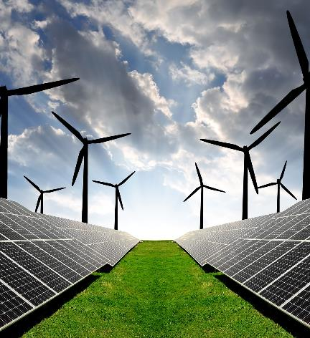
Hospitals making the switch to renewable energy:
Practice Greenhealth has measured a 167% increase in hospitals reporting they generate or purchase renewable energy since 2014-- 56% of hospitals report generating onsite or purchasing off-site renewable energy
Gundersen Health System was the first health system to become energy independent by relying on a mix of local renewable energy sources
Renewable energy in health care
Hospitals, health centers, and health systems around the world are joining with cities, businesses, and higher education to increasingly deploy solar, wind, and other sources of clean, renewable energy.
Renewable energy is healthy energy and protects patients and communities from fossil fuel pollution and climate change
Renewable energy can save health facilities money by providing a fixed cost for a long-term energy supply
Onsite renewable energy can help a health facility maintain power when extreme weather hits

Slide 17
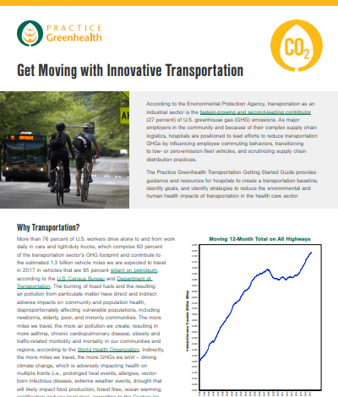
How hospitals are optimizing transportation:
St. Cloud VA Health Care system calculated GHG reduction of 9,101 metric tons CO2e due to telework assignments
Seattle Children’s Hospital’s program that encouraged and rewarded employees for adopting alternative commuting practices allowed the hospital to save the $25 million it originally planned to spend on a new parking structure.
Baystate Medical Center has built a multi-pronged approach to fleet vehicles that tackles vehicular maintenance, route optimization, and systematization.
Transportation in health care
The burning of fossil fuels and the resulting air pollution from particulate matter have direct and indirect adverse impacts on community and population health
Transportation as an industrial sector is the fastest-growing and second-leading contributor (27 percent) of U.S. greenhouse gas (GHG) emissions
Air pollution from particulate matter have direct and indirect adverse impacts on community and population health
Patients, employees, and the larger community benefit from the reduction in dangerous, unhealthy emissions from fossil-fuel burning vehicles.

Slide 18

THANK YOU
EUGENIA GIBBONS
Boston Director of Climate Policy
Health Care Without Harm | Practice Greenhealth
EGIBBONS@HCWH.ORG

Slide 19
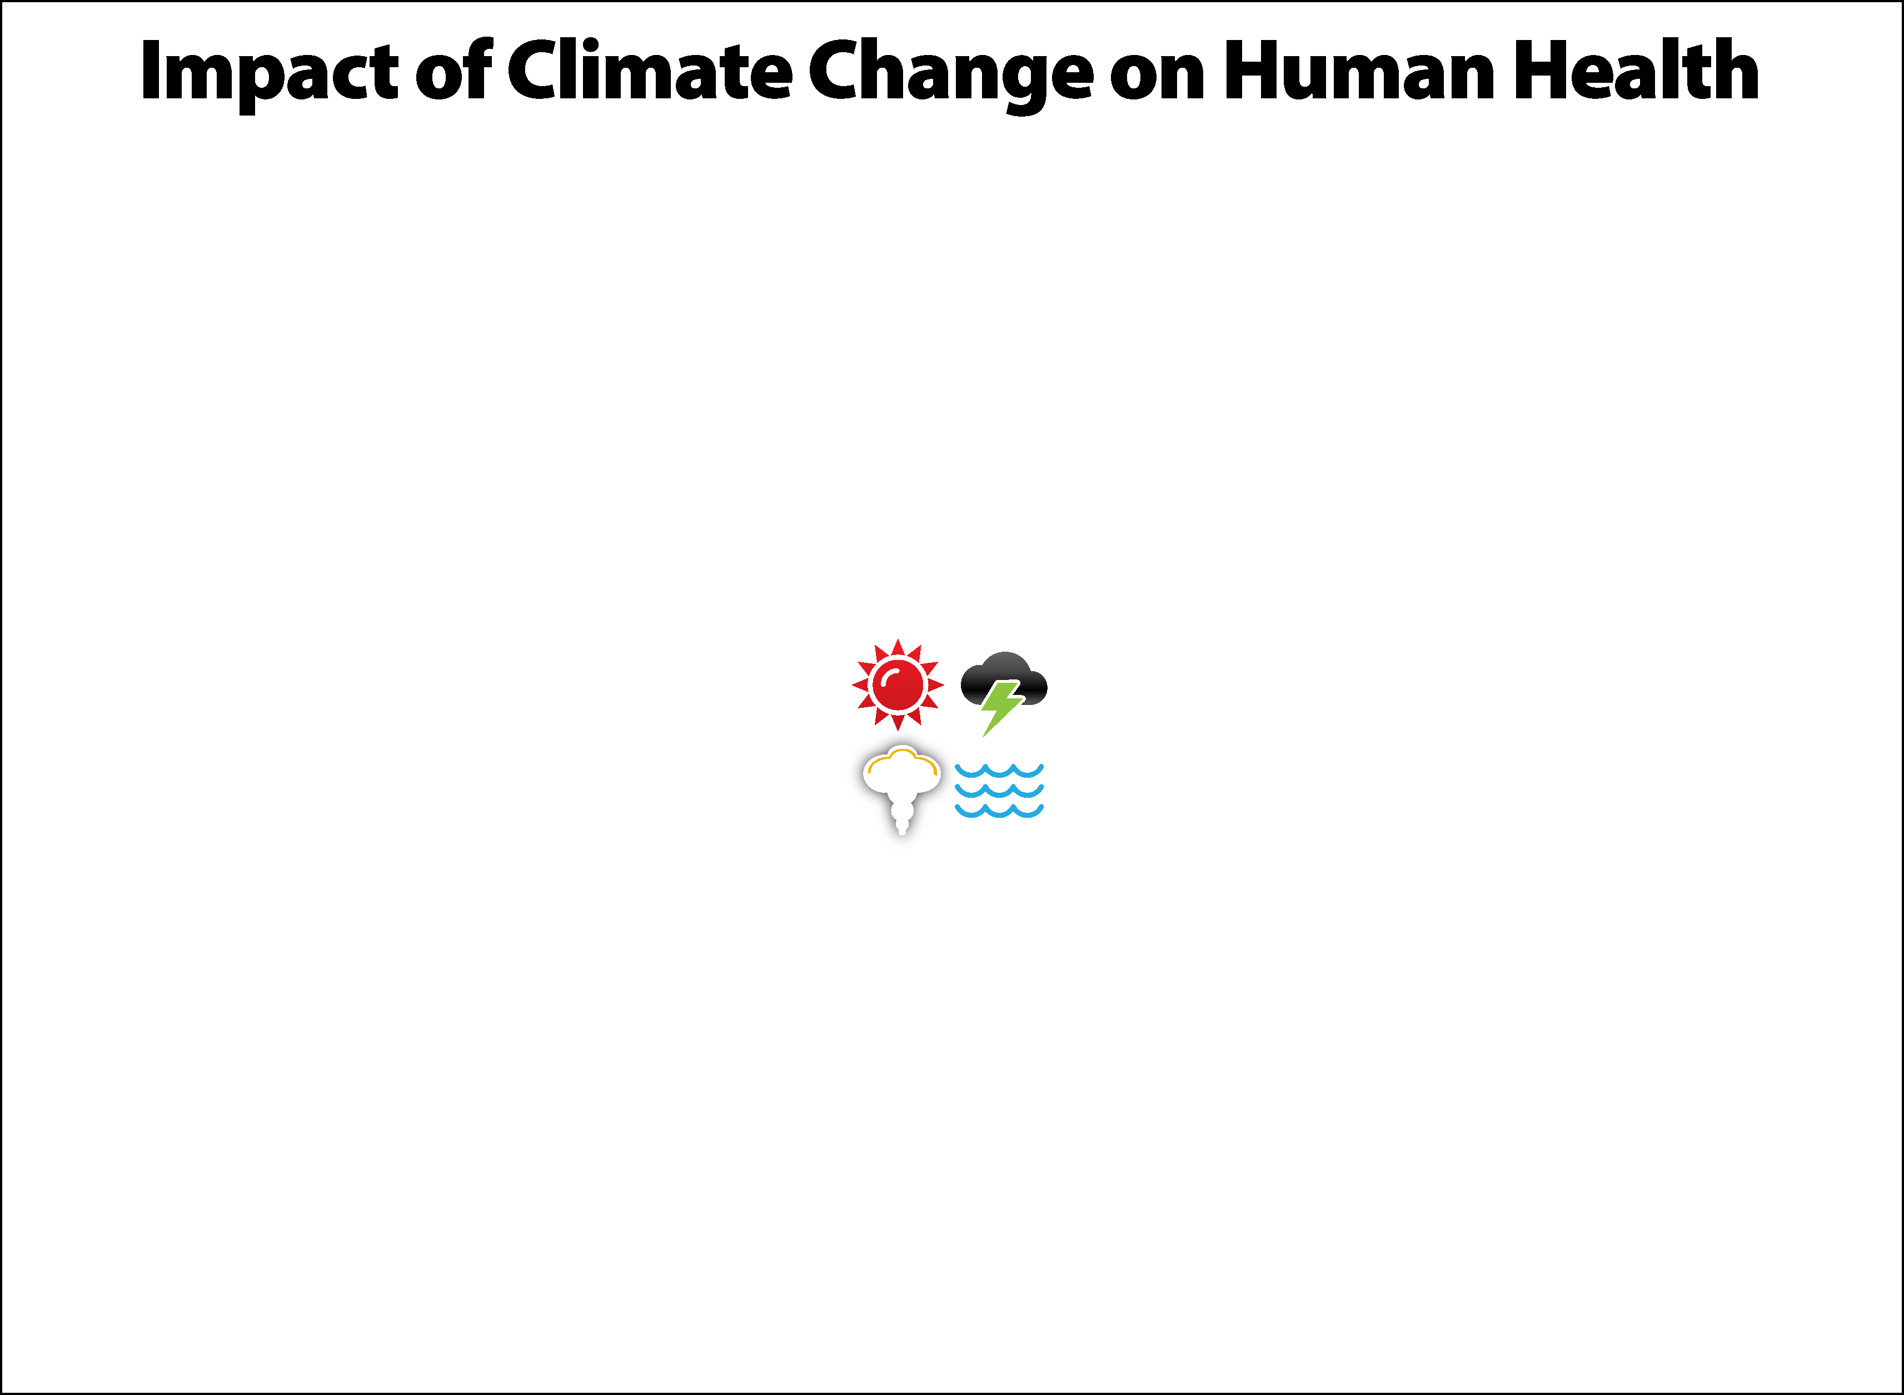
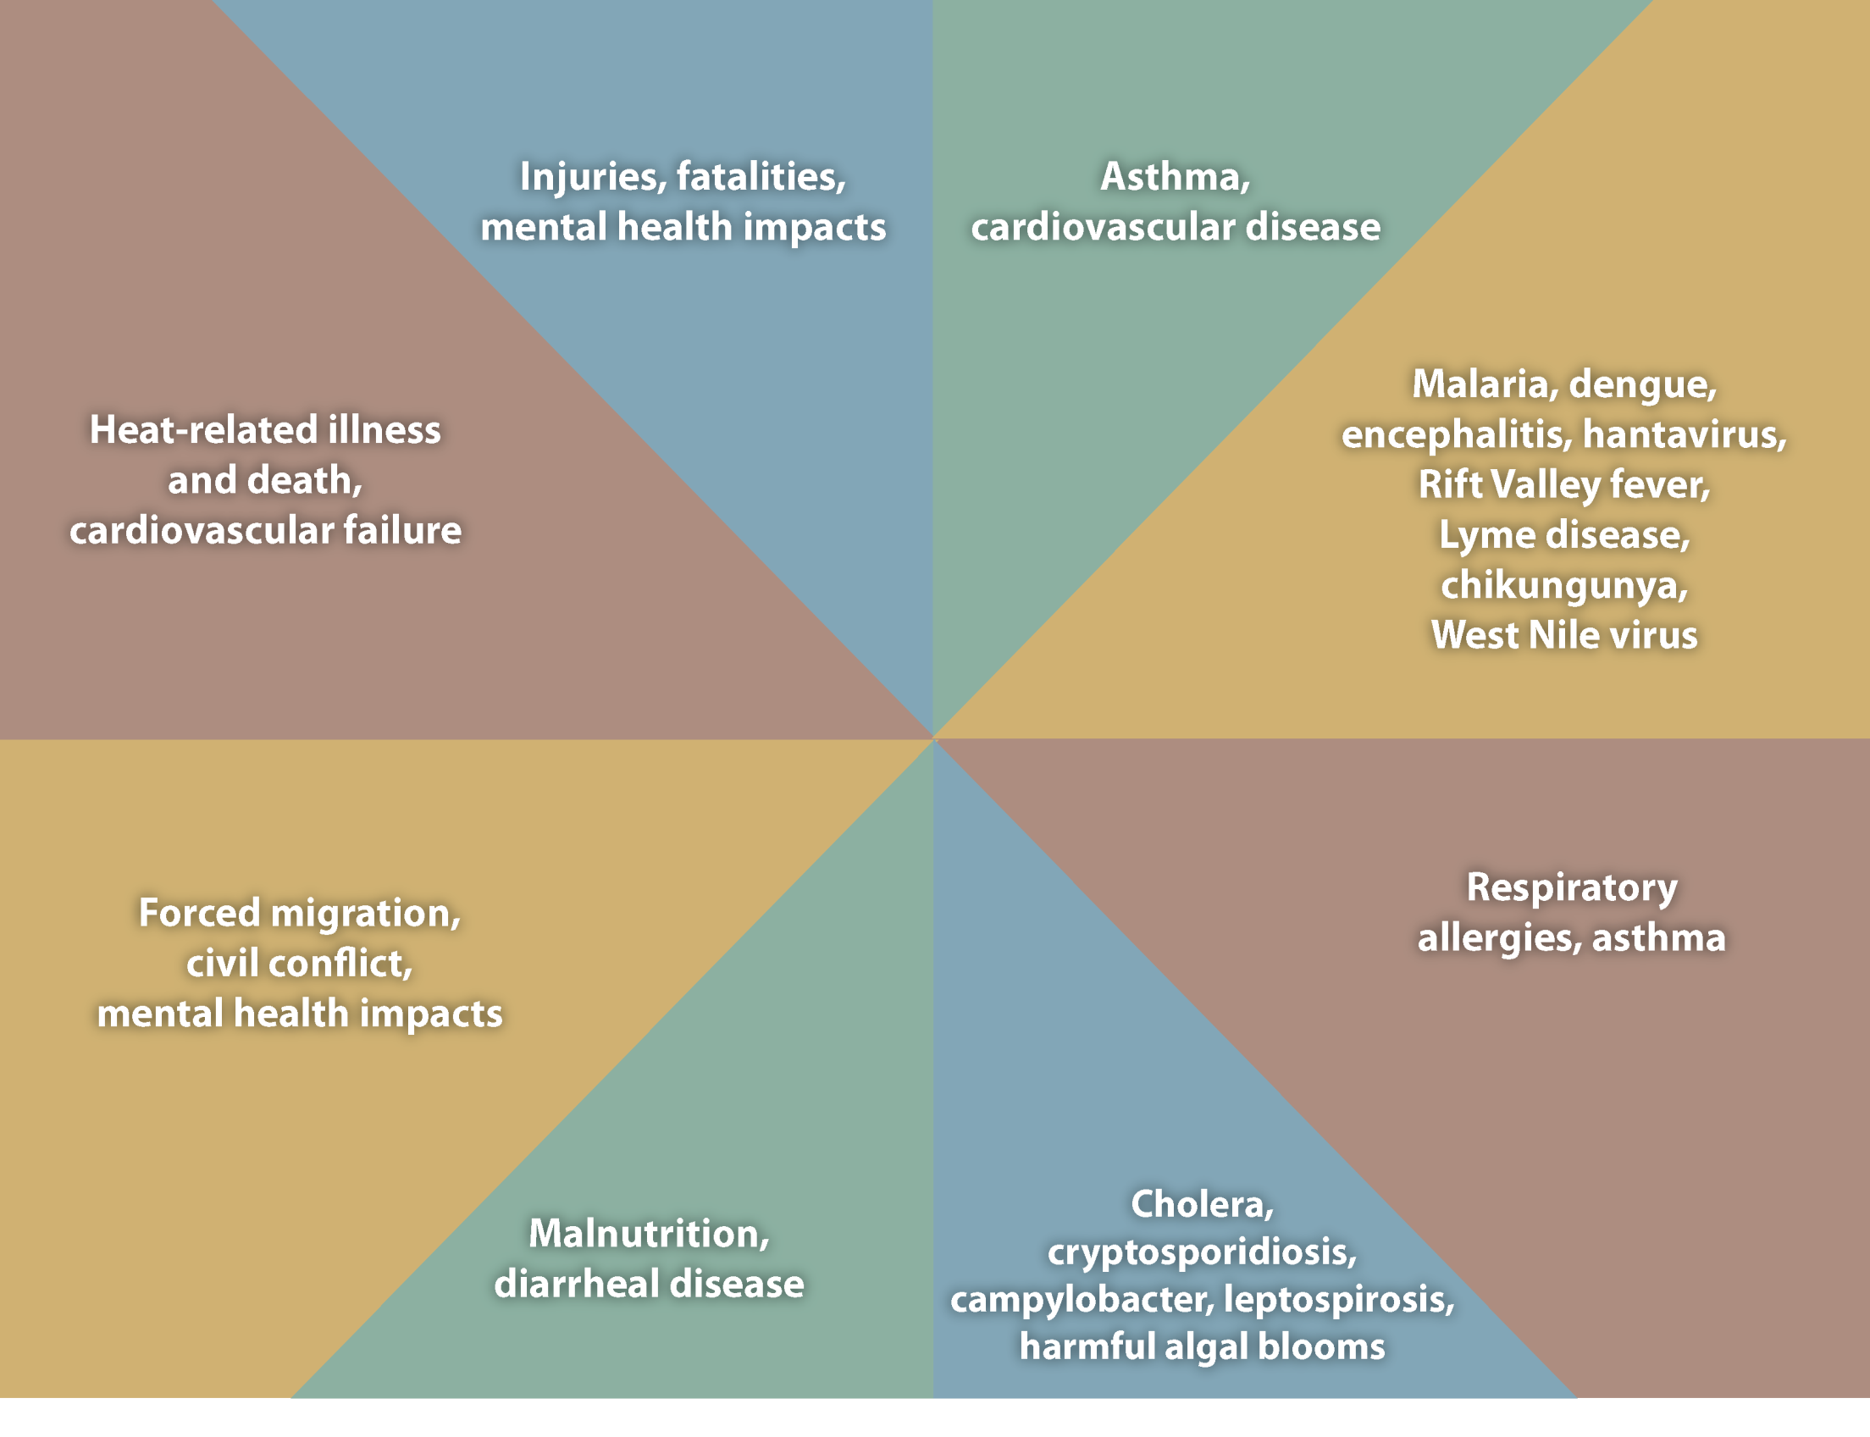
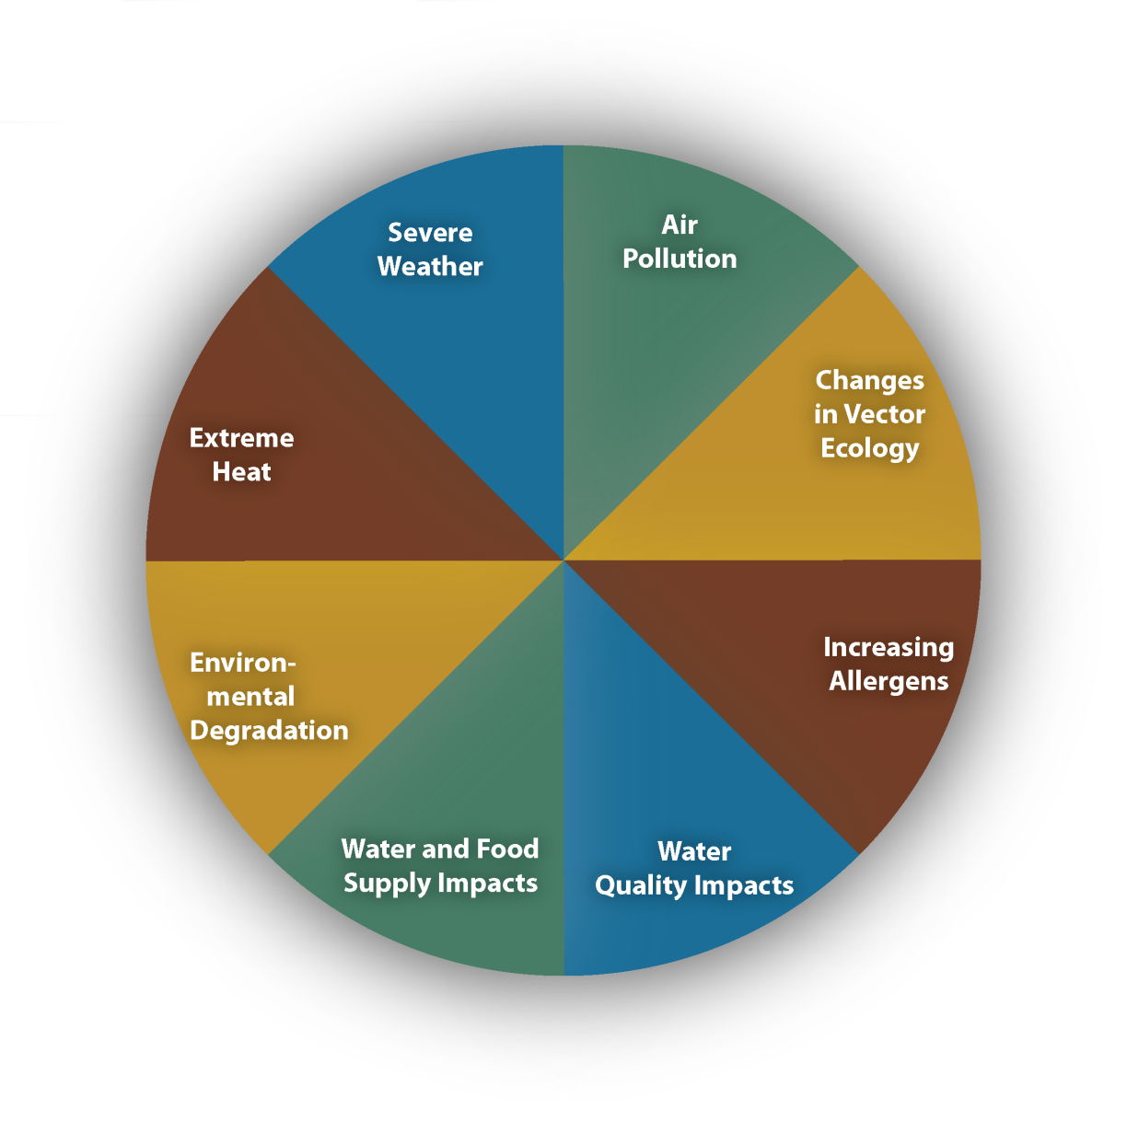
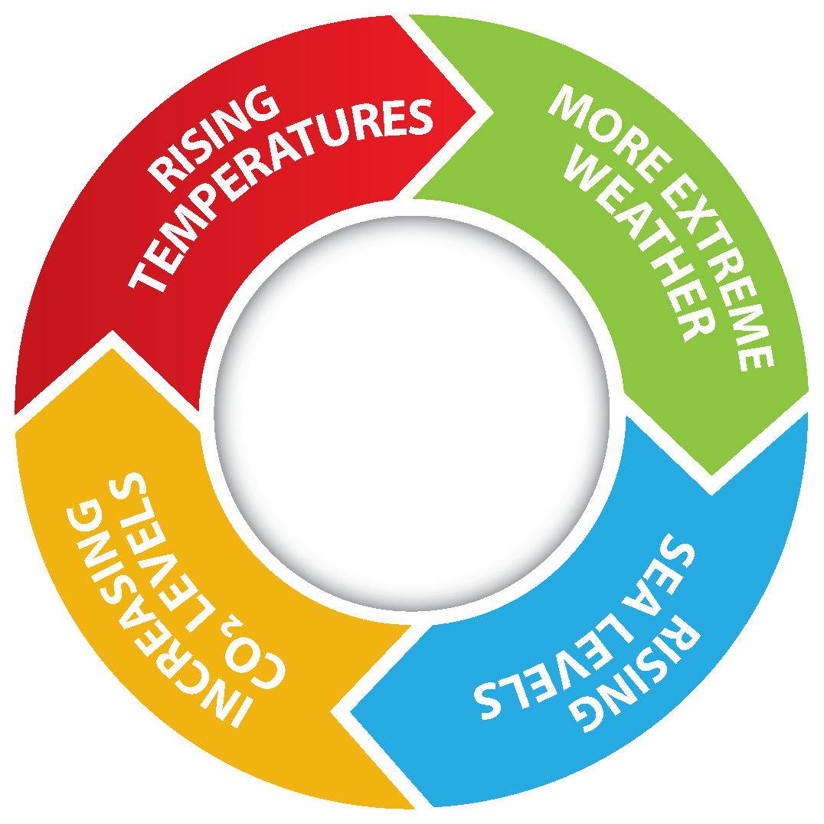
Notes:
Climate change impacts a wide-range of health outcomes. This slide illustrates the most significant climate change impacts (rising temperatures, more extreme weather, rising sea levels, and increasing carbon dioxide levels), their effect on exposures, and the subsequent health outcomes that can result from these changes in exposures.

